Slide 1

IT 2203 Combinational Logic
Dr. Md. Sazzadur Rahman
Assistant Professor
Institute of Information Technology
Jahangirnagar University, Savar, Dhaka.
1

Slide 2
Outlines
Introduction
Motivation
Review of Boolean Algebra
Transformation of Logic Gates
Specification
Synthesis
2

Slide 3
Motivation: Combinational Logic
Description
Language
Boolean algebra
Truth table
Schematic Diagram
Inputs, Gates, Nets, Outputs
Goal
Validity: correctness, turnaround time
Performance: power, timing, cost
Testability: yield, diagnosis, robustness
3

Slide 4
Motivation: Combinational Logic vs. Boolean Algebra Expression
a
b
a·b
a·b + c·d
c
d
y=e·(a·b+c·d)
c·d
e
Schematic Diagram:
5 primary inputs, 1 primary output
4 components (gates)
9 signal nets
12 pins
Boolean Algebra:
5 literals
4 operators
Obj: min #terms
min #literals
4

Slide 5
Motivation: iClicker
a
b
a·b
Schematic Diagram:
5 primary inputs
4 components (gates)
9 signal nets
12 pins
a·b + c·d
c
d
y=e·(a·b+c·d)
c·d
Boolean Algebra:
5 literals
4 operators
e
#inputs
#gates
#nets
#pins
None
#operators
#literals + #operators
#literals + 2 #operators
5

Slide 6
Schematic Diagram vs. Boolean Expression
Boolean Expression: #literals, #operators
Schematic Diagram: #gates, #nets, #pins
One more example?
6

Slide 7
Some Definitions
Complement: variable with a bar over it
A, B, C
Literal: variable or its complement
A, A, B, B, C, C
Implicant: product of literals
ABC, AC, BC
Minterm: product that includes all input variables
ABC, ABC, ABC
Maxterm: sum that includes all input variables
(A+B+C), (A+B+C), (A+B+C)
2-<7>

Slide 8
Digital Discipline: Binary Values
Typically consider only two discrete values:
1’s and 0’s
1, TRUE, HIGH
0, FALSE, LOW
1 and 0 can be represented by specific voltage levels, rotating gears, fluid levels, etc.
Digital circuits usually depend on specific voltage levels to represent 1 and 0
Bit: Binary digit
1-<8>
8

Slide 9
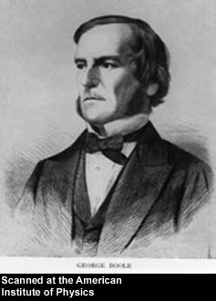
George Boole, 1815 - 1864
Born to working class parents
Taught himself mathematics and joined the faculty of Queen’s College in Ireland.
Wrote An Investigation of the Laws of Thought (1854)
Introduced binary variables
Introduced the three fundamental logic operations: AND, OR, and NOT.
1-<9>
1-<9>

Slide 10
Review of Boolean Algebra
Let B be a non empty set with two binary operations, a unary operation, and two distinct elements 0 and 1. Then B is called a Boolean algebra if the following axioms hold.
Commutative laws: a+b = b+a, a·b = b·a
Distributive laws: a+(b·c) = (a+b)·(a+c), a·(b+c) = a·b+a·c
Identity laws: a+0=a, a·1=a
Complement laws: a+a’=1, a·a’=0
<10>

Slide 11
Switching Algebra (A subset of Boolean Algebra)
Boolean Algebra: Each variable may have multiple values.
Switching Algebra: Each variable can be either 1 or 0. The constraint simplifies the derivations.
BB
Boolean Algebra
Switching Algebra
Two Level Logic
<11>

Slide 12
Switching Algebra
Two Level Logic: Sum of products, or product of sums, e.g. ab + a’c + a’b’, (a’+c )(a+b’)(a+b+c’)
Multiple Level Logic: Many layers of two level logic with some inverters, e.g. (((a+bc)’+ab’)+b’c+c’d)’bc+c’e
Features of Digital Logic Design
Multiple Outputs
Don’t care sets
Handy Tools:
DeMorgan’s Law: Complements
Consensus Theorem
Shannon’s Expansion
Truth Table
Karnaugh Map (single output, two level logic)
BB
Boolean Algebra
Switching Algebra
Two Level Logic
<12>

Slide 13
Review of Boolean algebra and switching functions
AND, OR, NOT
AND
OR
NOT
A B Y
0 0 0
0 1 0
1 0 0
1 1 1
A B Y
0 0 0
0 1 1
1 0 1
1 1 1
A Y
0 1
1 0
A
1
A
1
A
1
A
0
A
0
0
A
0 dominates in AND
0 blocks the output
1 passes signal A
1 dominates in OR
1 blocks the output
0 passes signal A
13

Slide 14
1. Identity A * 1 = A A + 1 = 1
A * 0 = 0 A + 0 = A
2. Complement A + A’ = 1 A * A’ = 0
T8. Distributive Law
A(B+C) = AB + AC
A+BC = (A+B)(A+C)
A
B
A
B
C
A
C
A
B
A
B
C
A
C
14

Slide 15
T7. Associativity
(A+B) + C = A + (B+C)
(AB)C = A(BC)
C
A
A
B
B
C
C
A
A
B
B
C
T12. DeMorgan’s Law (A+B)’ = A’B’ (AB)’ = A’ + B’
T11. Consensus Theorem AC + AB + BC’ = AC + BC’
15

Slide 16
DeMorgan’s Theorem
Y = AB = A + B
Y = A + B = A B
1-<16>

Slide 17
Bubble Pushing
Pushing bubbles backward (from the output) or forward (from the inputs) changes the body of the gate from AND to OR or vice versa.
Pushing a bubble from the output back to the inputs puts bubbles on all gate inputs.
Pushing bubbles on all gate inputs forward toward the output puts a bubble on the output and changes the gate body.
1-<17>

Slide 18
Consensus Theorem
AB+AC+B’C
=AB+B’C
(A+B)(A+C)(B’+C)
=(A+B)(B’+C)
Exercise: to prove the reduction using
Boolean algebra,
Logic simulation and
Shannon’s expansion
1-<18>

Slide 19
Consensus Theorem: iClicker
Which term in AB’+AC+BC can be deleted?
AB’
AC
BC
None of the above
1-<19>

Slide 20
Shannon’s Expansion
Shannon’s expansion assumes a switching algebra system
Divide a switching function into smaller functions
Pick a variable x, partition the switching function into two cases: x=0 and x=1
f(x)=xf(1)+x’f(0)
f(x,y)=xf(1,y)+x’f(0,y)
f(x,y,z,…)=xf(1,y,z,…)+x’f(0,y,z,…)
<20>

Slide 21
Shannon’s Expansion: iClicker
f(x,y,z)=xf(?,y,z)+x’f(?,y,z)
?=0
?=1.
f(x,y)=(x+f(?,y))(x’+f(?,y))
A. ?=0
B. ?=1.
<21>

Slide 22
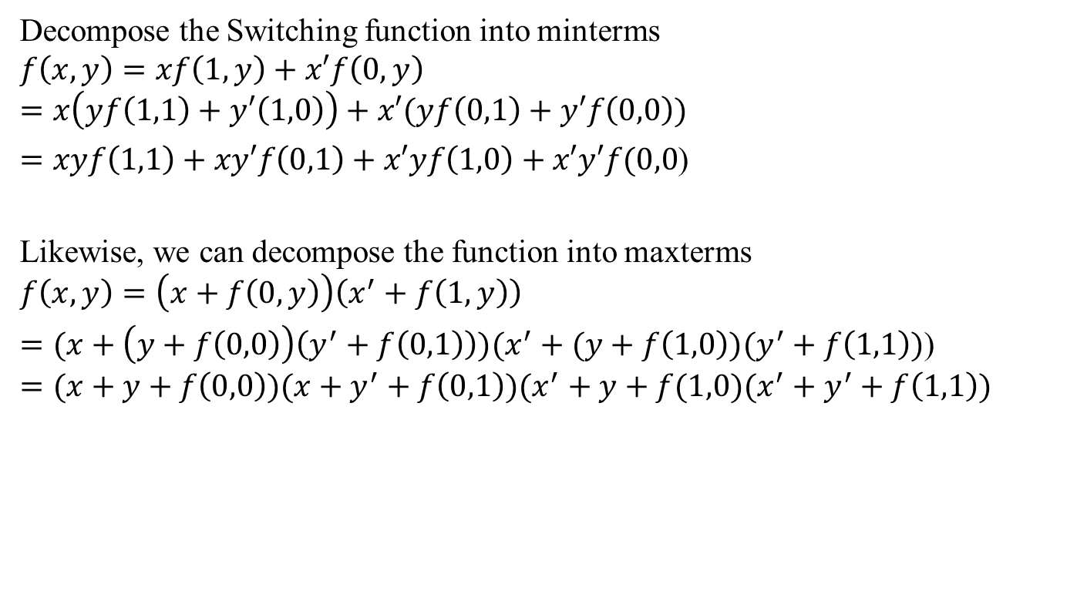
Shannon’s Expansion
<22>

Slide 23
Switching Algebra
Shannon’s expansion and consensus theorem are used for logic optimization
Shannon’s expansion divides the problem into smaller functions
Consensus theorem finds common terms when we merge small functions
Karnaugh map mimics the above two operations in two dimensional space as visual aids.
1-<23>

Slide 24
Part I. Combinational Logic
I) Specification
a. Language
b. Truth Table
c. Boolean Algebra
Canonical Expression: Sum of minterms and
Product of maxterms
d. Incompletely Specified Function
24

Slide 25
Binary Addition
5
+ 7
1 2
Carry Sum
1 1 1
1 0 1
+ 1 1 1
Carry bits
5
7
12
1 1 0 0
Carryout Sums
25

Slide 26
Binary Addition: Hardware
Half Adder: Two inputs (a,b) and two outputs (carry, sum).
Full Adder: Three inputs (a,b,c) and two outputs (carry, sum).
26

Slide 27
Half Adder
Truth Table
a
a b carry sum
0 0 0 0
0 1 0 1
1 0 0 1
1 1 1 0
Sum
b
Carry
27

Slide 28
Switching Function
Switching Expressions:
Sum (a,b) = a’·b + a·b’
Carry (a,b) = a·b
Ex:
Sum (0,0) = 0’·0 + 0·0’ = 0 + 0 = 0
Sum (0,1) = 0’·1 + 0·1’ = 1 + 0 = 1
Sum (1,1) = 1’·1 + 1·1’ = 0 + 0 = 0
a
a
sum
carry
b
b
28

Slide 29
Full Adder
Truth Table
C_{in}
Id a b c_{in} carry sum
0 0 0 0 0 0
1 0 0 1 0 1
2 0 1 0 0 1
3 0 1 1 1 0
4 1 0 0 0 1
5 1 0 1 1 0
6 1 1 0 1 0
7 1 1 1 1 1
a
Sum
b
Carry
29

Slide 30
Minterm and Maxterm
Id a b c_{in} carryout
0 0 0 0 0 a+b+c
1 0 0 1 0 a+b+c’
2 0 1 0 0 a+b’+c
3 0 1 1 1 a’ b c
4 1 0 0 0 a’+b+c
5 1 0 1 1 a b’c
6 1 1 0 1 a b c’
7 1 1 1 1 a b c
minterm
maxterm
30

Slide 31
Minterms
f₁(a,b,c) = a’bc + ab’c + abc’ + abc
a’bc = 1 iff (a,b,c,) = (0,1,1)
ab’c = 1 iff (a,b,c,) = (1,0,1)
abc’ = 1 iff (a,b,c,) = (1,1,0)
abc = 1 iff (a,b,c,) = (1,1,1)
f₁(a,b,c) = 1 iff (a,b,c) = (0,1,1), (1,0,1), (1,1,0), or (1,1,1)
Ex: f₁(1,0,1) = 1’01 + 10’1 + 101’ + 101 = 1
f₁(1,0,0) = 1’00 + 10’0 + 100’ + 100 = 0
31

Slide 32
Maxterms
f₂(a,b,c) = (a+b+c)(a+b+c’)(a+b’+c)(a’+b+c)
a + b + c = 0 iff (a,b,c,) = (0,0,0)
a + b + c’ = 0 iff (a,b,c,) = (0,0,1)
a + b’ + c = 0 iff (a,b,c,) = (0,1,0)
a’ + b + c = 0 iff (a,b,c,) = (1,0,0)
f₂(a,b,c) = 0 iff (a,b,c) = (0,0,0), (0,0,1), (0,1,0), (1,0,0)
Ex: f₂(1,0,1) = (1+0+1)(1+0+1’)(1+0’+1)(1’+0+1) = 1
f₂(0,1,0) = (0+1+0)(0+1+0’)(0+1’+0)(0’+1+0) = 0
32

Slide 33
f₁(a,b,c) = a’bc + ab’c + abc’ + abc
f₂(a,b,c) = (a+b+c)(a+b+c’)(a+b’+c)(a’+b+c)
f₁(a, b, c) = m₃ + m₅ + m₆ + m₇ = Σm(3,5,6,7)
f₂(a, b, c) = M₀M₁M₂M₄ = ΠM(0, 1, 2, 4)
iClicker: Does f₁ = f₂?
Yes
No.
33

Slide 34
The coverage of a single minterm. E.g. m₄ = ab’c’
Id a b c_{in} carry minterm ₄ = ab’c’
0 0 0 0 0 0
1 0 0 1 0 0
2 0 1 0 0 0
3 0 1 1 1 0
4 1 0 0 0 1
5 1 0 1 1 0
6 1 1 0 1 0
7 1 1 1 1 0
Only one row has a 1.
34

Slide 35
The coverage of a single maxterm. E.g. M₄ = a’+b+c
Id a b c_{in} carry maxterm ₄ = a+b+c
0 0 0 0 0 1
1 0 0 1 0 1
2 0 1 0 0 1
3 0 1 1 1 1
4 1 0 0 0 0
5 1 0 1 1 1
6 1 1 0 1 1
7 1 1 1 1 1
Only one row has a 0.
35

Slide 36
Incompletely Specified Function
Don’t care set is important because it allows us to
minimize the function
Id a b f (a, b)
0 0 0 1
1 0 1 0
2 1 0 1
3 1 1 -
The input does not happen.
The input happens, but the output is ignored.
Examples:
Decimal number 0… 9 uses 4 bits. (1,1,1,1) does not happen.
Final carry out bit (output is ignored).
36

Slide 37
Incompletely Specified Function
g₁(a,b,c)=a’b’c+a’bc+ab’b’+abc
=m₁+m₃+m₄+m₇
=∑ m(1,3,4,7)
g₂(a,b,c)=(a+b+c)(a’+b’+c)
=M₀M₆
=∏M(0,6)
Id a b c g(a,b,c)
0 0 0 0 0
1 0 0 1 1
2 0 1 0 -
3 0 1 1 1
4 1 0 0 1
5 1 0 1 -
6 1 1 0 0
7 1 1 1 1
iClicker: Does g₁(a,b,c) = g₂(a,b,c)?
A.Yes
B. No
37

